Slide 1
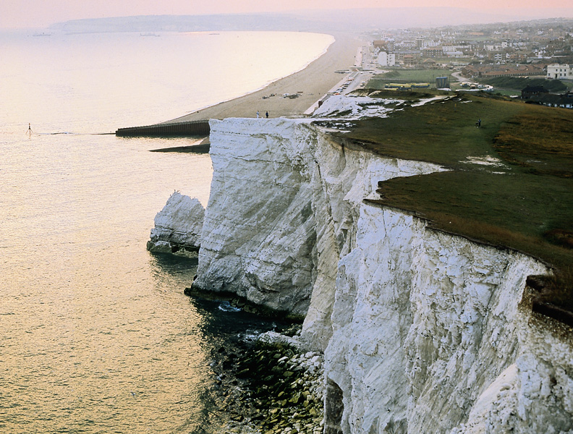
Chapter 19: Solubility and Complex-Ion Equilibria
General Chemistry
Principles and Modern Applications
Petrucci • Harwood • Herring
8th Edition
Philip Dutton
University of Windsor, Canada
N9B 3P4
Prentice-Hall © 2002

Slide 2
Contents
19-1 The Solubility Product Constant, K_{sp}
19-2 The Relationship Between Solubility and K_{sp}
19-3 The Common-Ion Effect in Solubility Equilibria
19-4 Limitations of the K_{sp} Concept
19-5 Criteria for Precipitation and Its Completeness
19-6 Fractional Precipitation
19-7 Solubility and pH
19-8 Equilibria Involving Complex Ions
19-9 Qualitative Cation Analysis
Focus On Shells, Teeth, and Fossils

Slide 3
19-1 The Solubility Product Constant, K_{sp}
The equilibrium constant for the equilibrium established between a solid solute and its ions in a saturated solution.
CaSO₄(s)  Ca²⁺(aq) + SO₄²⁻(aq)
K_{sp} = [Ca²⁺][SO₄²⁻] = 9.110⁻⁶ at 25°C
Notes:
Gypsum, CaSO₄·H₂O
Write equilibrium expression as per Ch16 (p 636), include dissolved species but not anything in the solid state.

Slide 4
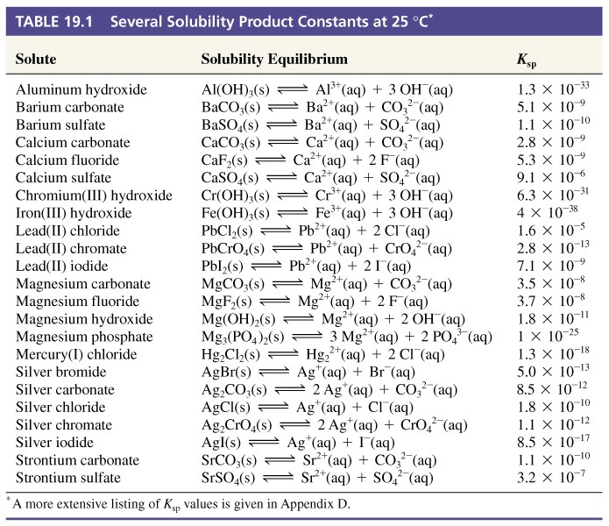
Table 19-1 Several Solubility Product Constants at 25°C

Slide 5
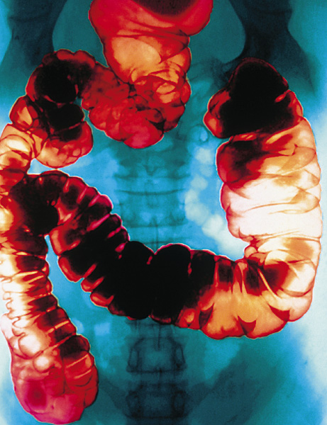
The Relationship Between
Solubility and K_{sp}
Molar solubility.
  The molarity in a saturated aqueous solution.
  Related to K_{sp}
g BaSO₄/100 mL → mol BaSO₄/L
→ [Ba²⁺] and [SO₄²⁻]
→ K_{sp} = 1.110⁻¹⁰

Slide 6
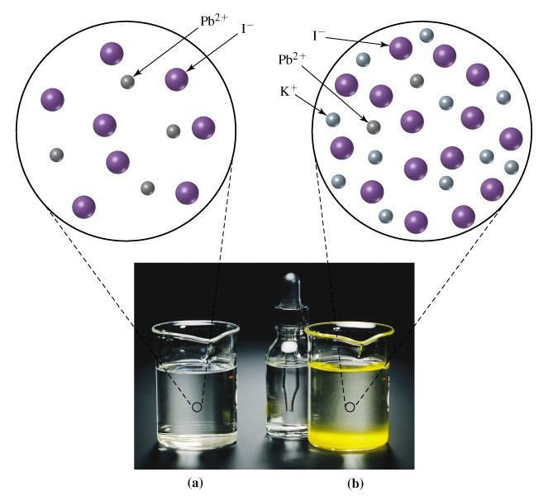
19-3 The Common-Ion Effect in Solubility Equilibria

Slide 7
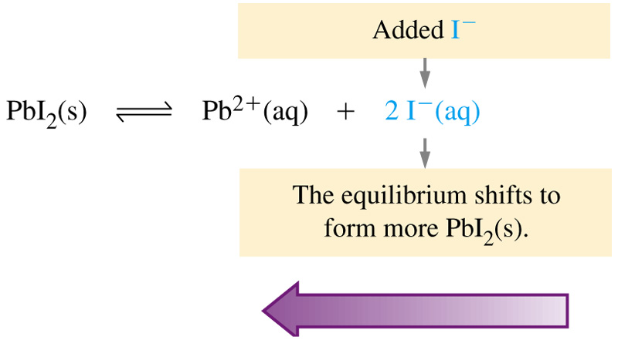
The Common-Ion Effect and
Le Chatelliers Principle

Slide 8
19-4 Limitations of the K_{sp} Concept
K_{sp} is usually limited to slightly soluble solutes.
  For more soluble solutes we must use ion activities
Activities (effective concentrations) become smaller than the measured concentrations.
The Salt Effect (or diverse ion effect).
  Ionic interactions are important even when an ion is not apparently participating in the equilibrium.
    Uncommon ions tend to increase solublity.

Slide 9
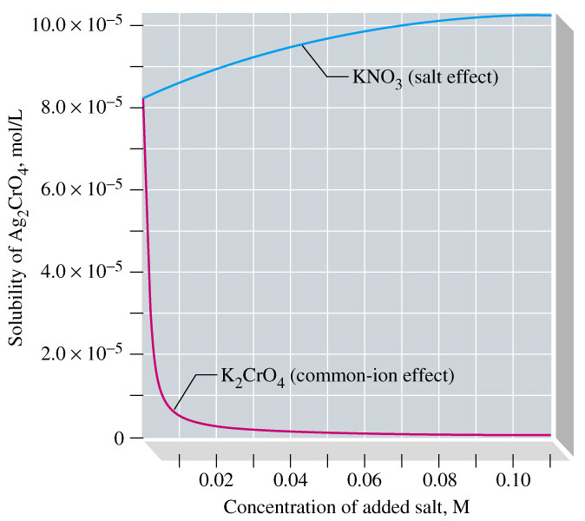
Effects on the Solubility of Ag₂CrO₄

Slide 10
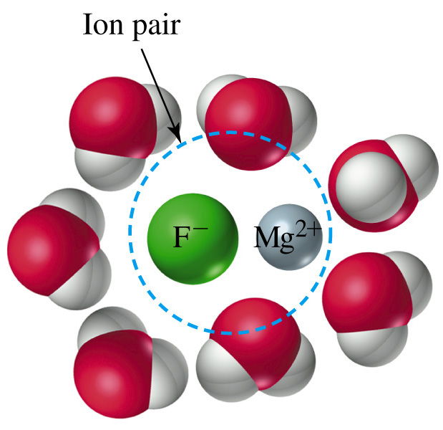
Ion Pairs

Slide 11
Incomplete Dissociation
Assumption that all ions in solution are completely dissociated is not valid.
Ion Pair formation occurs.
  Some solute “molecules” are present in solution.
  Increasingly likely as charges on ions increase.
K_{sp} (CaSO₄) = 2.310⁻⁴ by considering solubility in g/100 mL
Table 19: K_{sp} = 9.110⁻⁶
Activities take into account ion pair formation and must be used.

Slide 12
Simultaneous Equilibria
Other equilibria are usually present in a solution.
  K_{w} for example.
  These must be taken into account if they affect the equilibrium in question.

Slide 13
19-5 Criteria for Precipitation and Its Completeness
AgI(s)  Ag⁺(aq) + I⁻(aq)
K_{sp} = [Ag⁺][Cl⁻] = 8.510⁻¹⁷
Mix AgNO₃(aq) and KI(aq) to obtain a solution that is 0.010 M in Ag⁺ and 0.015 M in I⁻.
Saturated, supersaturated or unsaturated?
Q = [Ag⁺][Cl⁻] = (0.010)(0.015) = 1.510⁻⁴ > K_{sp}

Slide 14
The Ion Product
Q is generally called the ion product.
Q > K_{sp} Precipitation should occur.
Q = K_{sp} The solution is just saturated.
Q < K_{sp} Precipitation cannot occur.

Slide 15
Example 19-5
Applying the Criteria for Precipitation of a Slightly Soluble Solute.
Three drops of 0.20 M KI are added to 100.0 mL of 0.010 M Pb(NO₃)₂. Will a precipitate of lead iodide form?
(1 drop = 0.05 mL)
PbI₂(s) → Pb²⁺(aq) + 2 I⁻(aq) K_{sp}= 7.110⁻⁹
Determine the amount of I⁻ in the solution:
0.05 mL
1 L
0.20 mol KI
1 mol I⁻
n_{I-} = 3 drops
1 drop
1000 mL
1 L
1 mol KI
= 310⁻⁵ mol I⁻

Slide 16
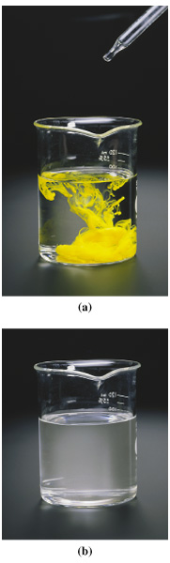
Example 19-5
Determine the concentration of I⁻ in the solution:
310⁻⁵ mol I⁻
[I⁻] =
= 310⁻⁴ mol I⁻
0.1000 L
Apply the Precipitation Criteria:
Q = [Pb²⁺][I⁻]² = (0.010)(310⁻⁴)²
= 910⁻¹⁰
< K_{sp} = 7.110⁻⁹

Slide 17
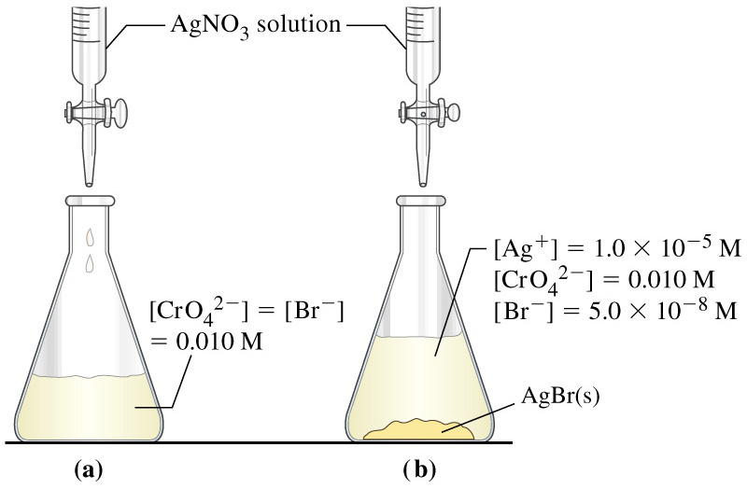
19-6 Fractional Precipitation
A technique in which two or more ions in solution are separated by the proper use of one reagent that causes precipitation of both ions.
Significant differences in solubilities are necessary.

Slide 18
19-7 Solubility and pH
Mg(OH)₂ (s)  Mg²⁺(aq) + 2 OH⁻(aq)
K_{sp} = 1.810⁻¹¹
OH⁻(aq) + H₃O⁺(aq)  H₂O(aq)
K = 1/K_{w} = 1.010¹⁴
2 OH⁻(aq) + 2 H₃O⁺(aq)  2 H₂O(aq)
K' = (1/K_{w})² = 1.010²⁸
Mg(OH)₂ (s) + H₃O⁺(aq)  Mg²⁺(aq) + 2 OH⁻(aq)
K = K_{sp}(1/K_{w})² = (1.810⁻¹¹)(1.010⁻¹⁴) = 1.810¹⁷
Notes:
pH can affect salt solubility to a large degree
Mg(OH)₂ is highly soluble in acidic solution.

Slide 19
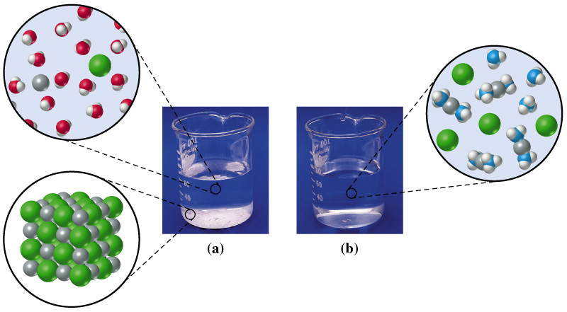
19-8 Equilibria Involving Complex Ions
AgCl(s) + 2 NH₃(aq) → [Ag(NH₃)₂]⁺(aq) + Cl⁻(aq)

Slide 20
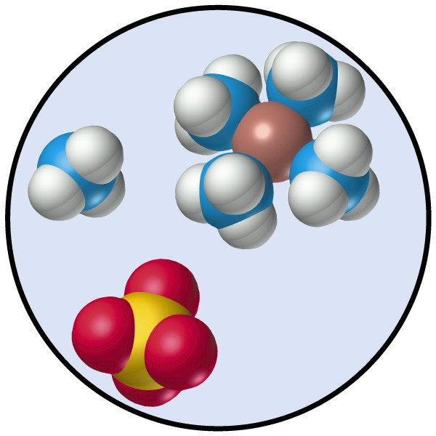
Complex Ions
Coordination compounds.
  Substances which contain complex ions.
Complex ions.
  A polyatomic cation or anion
  composed of:
    A central metal ion.
    Ligands

Slide 21
Formation Constant of Complex Ions
AgCl(s) + 2 NH₃(aq) → [Ag(NH₃)₂]⁺(aq) + Cl⁻(aq)
AgCl(s) → Ag⁺(aq) + Cl⁻(aq)
K_{sp} = 1.810⁻¹¹
Ag⁺(aq) + 2 NH₃(aq) → [Ag(NH₃)₂]⁺(aq)
[Ag(NH₃)₂]⁺
K_{f} =
= 1.610⁷
[Ag⁺]
[NH₃]²

Slide 22
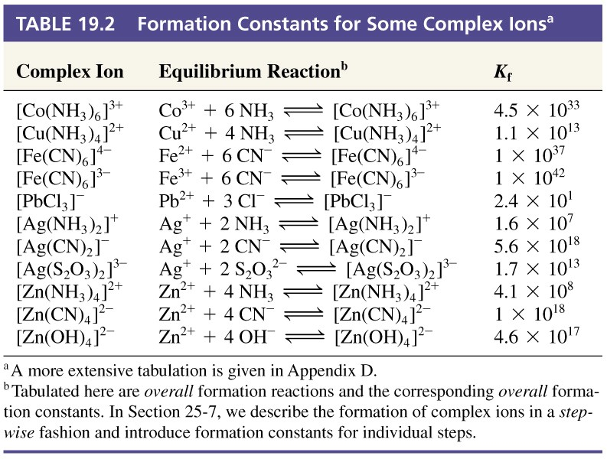
Table 19.2 Formation Constants for Some Complex Ions

Slide 23
Example 19-11
Determining Whether a Precipitate will Form in a Solution Containing Complex Ions.
A 0.10 mol sample of AgNO₃ is dissolved in 1.00 L of 1.00 M NH₃. If 0.010 mol NaCl is added to this solution, will AgCl(s) precipitate?
Assume K_{f} is large:
Ag⁺(aq) + 2 NH₃(aq) → [Ag(NH₃)₂]⁺(aq)
Initial conc. 0.10 M 1.00 M 0 M
Change -0.10 M -0.20 M +0.10 M
Eqlbrm conc. (0) M 0.80 M 0.10 M

Slide 24
Example 19-11
[Ag⁺] is small but not 0, use K_{f} to calculate [Ag+]:
Ag⁺(aq) + 2 NH₃(aq) → [Ag(NH₃)₂]⁺(aq)
Initial concs. 0 M 0.80 M 0.10 M
Changes +x M +2x M -x M
Eqlbrm conc. x M 0.80 + 2x M 0.10 - x M
[Ag(NH₃)₂]⁺
0.10-x
0.10
K_{f} =
=

= 1.610⁷
[Ag⁺]
[NH₃]²
x(0.80 + 2x)²
x(0.80)²
0.10
x = [Ag⁺] =
= 9.810⁻⁹ M
(1.6 10⁷)(0.80)²

Slide 25
Example 19-11
Compare Q_{sp} to K_{sp} and determine if precipitation will occur:
Q_{sp} =
[Ag⁺]
[Cl⁻]
= (9.810⁻⁹)(1.010⁻²) = 9.810⁻¹¹
K_{sp} = 1.810⁻¹⁰
Q_{sp} < K_{sp}
AgCl does not precipitate.

Slide 26
19-9 Qualitative Cation Analysis
An analysis that aims at identifying the cations present in a mixture but not their quantities.
Think of cations in solubility groups according to the conditions that causes precipitation
  chloride group hydrogen sulfide group ammonium sulfide group carbonate group.
  Selectively precipitate the first group of cations then move on to the next.

Slide 27
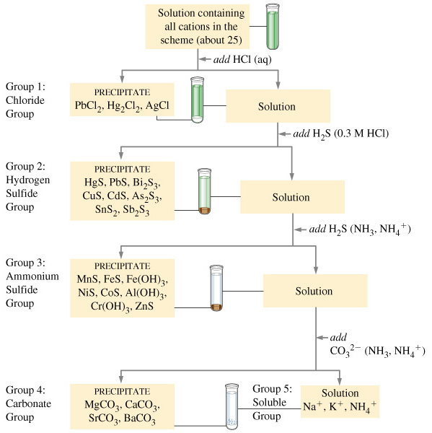
Qualitative
Cation
Analysis

Slide 28
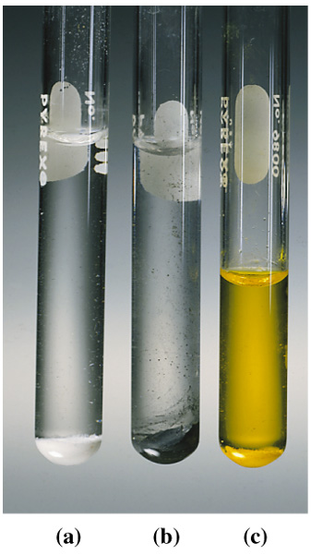
Chloride Group Precipitates
Group precipitate
Wash ppt with hot water PbCl₂ is slightly soluble. Test aqueous solution with CrO₄²⁻.
(c) Pb²⁺(aq) + CrO₄²⁻ → PbCrO₄(s)
Test remaining precipitate with ammonia.
(b) AgCl(s) + 2 NH₃(aq) →
Ag(NH₃)₂ (aq) + Cl⁻(aq)
(b) Hg₂Cl₂(a) + 2 NH₃ → Hg(l) + HgNH₂Cl(s)
+ NH₄⁺(aq) + Cl⁻(aq)

Slide 29
Hydrogen Sulfide Equilibria
H₂S(aq) + H₂O(l)  HS⁻(aq) + H₃O⁺(aq) K_{a1} = 1.010⁻⁷
HS⁻(aq) + H₂O(l)  S²⁻(aq) + H₃O⁺(aq) K_{a2} = 1.010⁻¹⁹
S²⁻ is an extremely strong base and is unlikely to be the
precipitating agent for the sulfide groups.

Slide 30
Lead Sulfide Equilibria
PbS(s) + H₂O(l)  Pb²⁺(aq) + HS⁻(aq) + OH⁻(aq)
K_{sp} = 310⁻²⁸
H₃O⁺(aq) + HS⁻(aq)  H₂S(aq) + H₂O(aq) 1/K_{a1} = 1.0/1.010⁻⁷
H₃O⁺(aq) + OH⁻(aq)  H₂O(l) + H₂O(l) 1/K_{w} = 1.0/1.010⁻¹⁴
PbS(s) + 2 H₃O(l)  Pb²⁺(aq) + H₂S(aq) + 2 H₂O(l)
K_{sp}
310⁻²⁸
K_{spa} =
=
= 310⁻⁷
K_{a1} K_{w}
1.010⁻⁷ 1.010⁻¹⁴

Slide 31
Dissolving Metal Sulfides
Several methods exist to re-dissolve precipitated metal sulfides.
  React with an acid.
    FeS readily soluble in strong acid but PbS and HgS are not because their K_{sp} values are too low.
  React with an oxidizing acid.
    3 CuS(aq) + 8 H⁺(aq) + 2 NO₃⁻(aq) →
    3 Cu²⁺(aq) + 3 S(s) + 2 NO(g) + 4 H₂O(l)

Slide 32
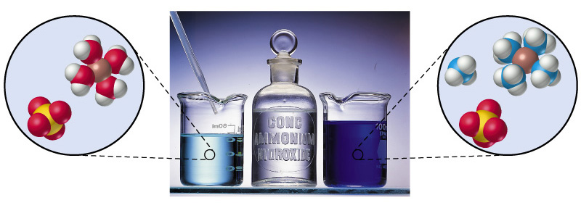
A Sensitive Test for Copper(II)
[Cu(H₂O)₄]²⁺(aq) + 4 NH₃(aq) → [Cu(NH₃)₄]²⁺(aq) + 4 H₂O(l)

Slide 33
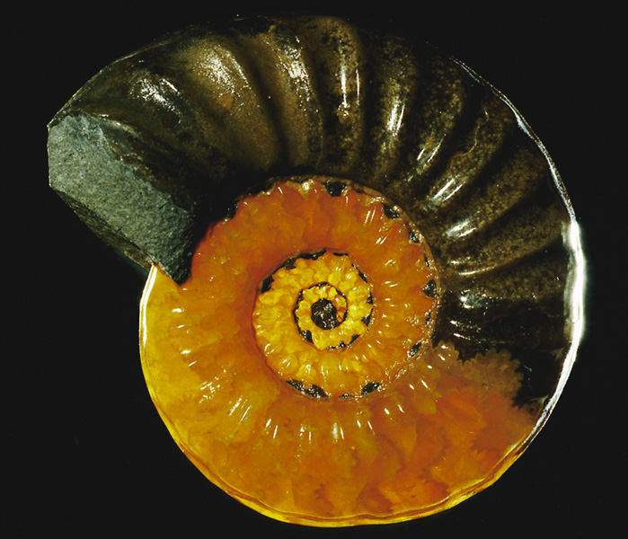
Focus On Shells, Teeth and Fossils
Calcite
Ca²⁺(aq) + 2 HCO₃⁻(aq) →
CaCO₃(s) + H₂O(l) + CO₂(g)
Hydroxyapatite
Fluoroapatite
Ca₅(PO₄)₃OH(s)
Ca₅(PO₄)₃F(s)
Ca₅(PO₄)₃OH(s) + 4 H₃O⁺(aq) → 5 Ca²⁺(s) + 5 H₂O(l) + 3 HPO₄²⁻(aq)

Slide 34
Chapter 19 Questions
Develop problem solving skills and base your strategy not on solutions to specific problems but on understanding.
Choose a variety of problems from the text as examples.
Practice good techniques and get coaching from people who have been here before.

